Slide 1
Software Projects
Student User Interface
Click to enter

Slide 2
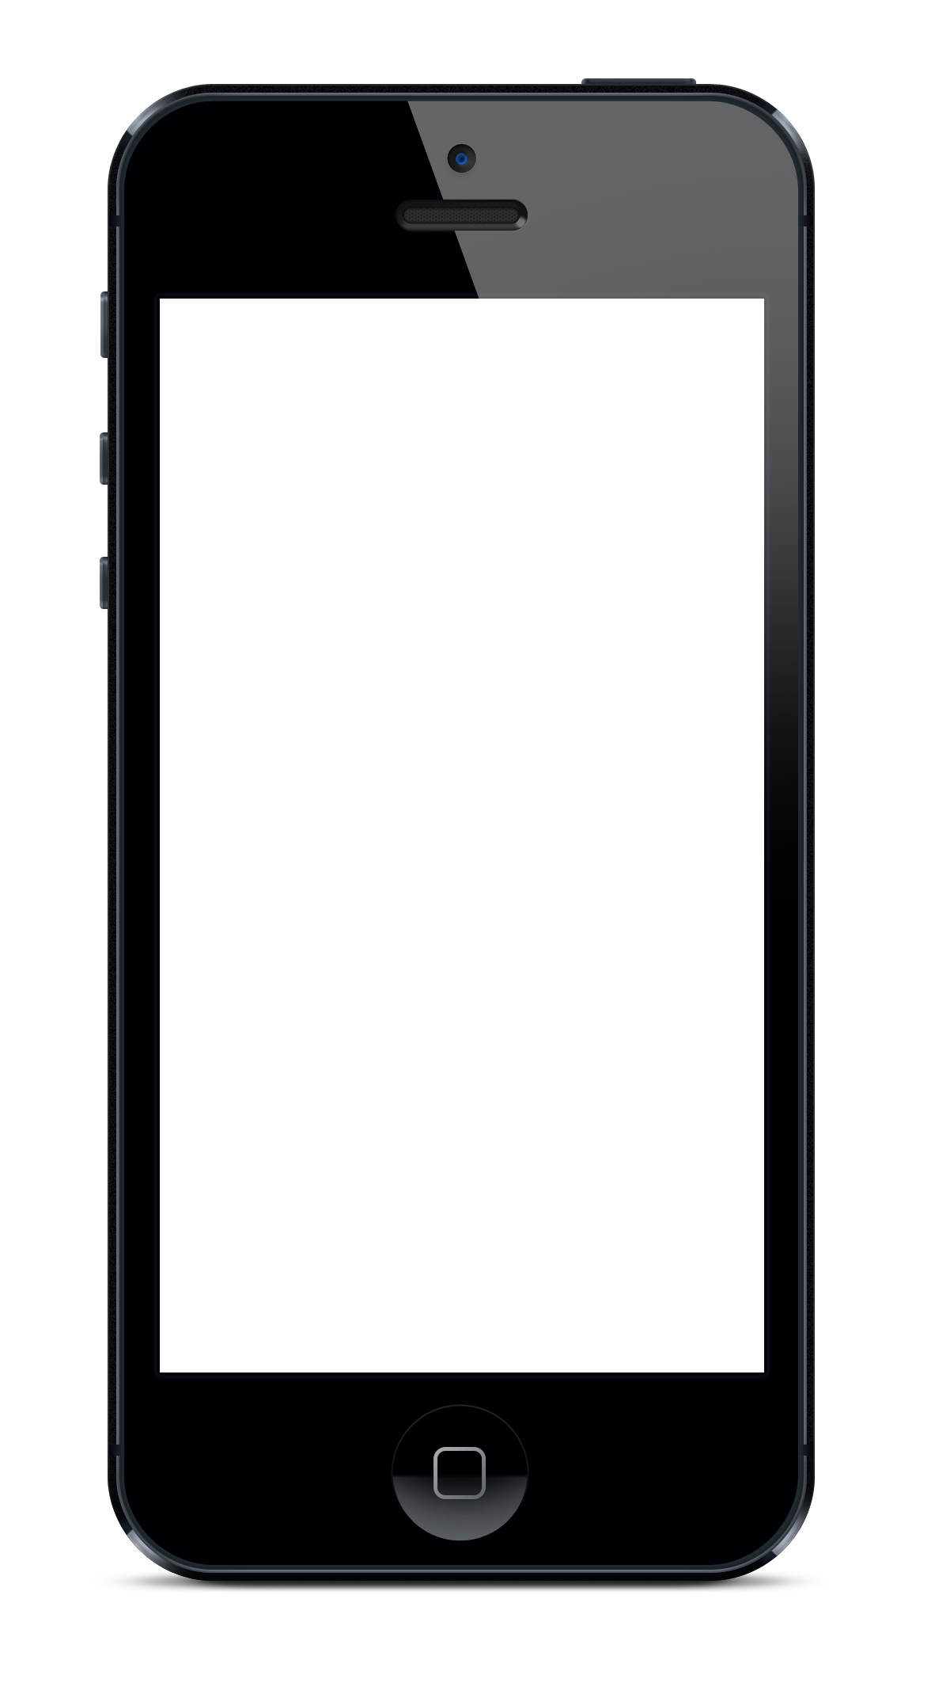



Account Selection
For the purposes of this presentation please use this account as a “Student”.
Select Your Account
Tutor
Parent

Slide 3
Login screen
HOME
Login with University credentials
Email Address
Password
Log In
Create Account
Forgotten Password?

Slide 4

Account creation
HOME
LOGO
Create Account
First Name
Last Name
Email Address
Password
Contact Number
Register
i
LOG IN

Slide 5





Profile page of Student
Profile
Picture
Student Name
Rating?
BIO
FEEDBACK
Your profile:
i
PROFILE
MORE
Please click here for the remainder of the presentation
Notes:
FIND A MATCH BETWEEN THE TUTOR AND PARENT

Slide 6


New job request
HOME
New Job
Click box for details
i
Student’s Name
Student’s School Year
Subjects child needs help with?
Job Description
Accept job
PROFILE
ACCEPT A JOB
MESSAGE PARENT
MORE

Slide 7

Instant messaging between Parent and Tutor
Picture
BACK
Parents Name
MORE
Parent
Parent
Parent
Message
Send
Notes:
BOTH USERS (PARENT & STUDENT) INTERACTS USING THE BUILD-IN IM CHAT AND AGREE ON A MEET UP

Slide 8

Tutor Feedback
Feedback
Your last session
Friday 10, 2017 18:00
i
Picture
Student Name:
Payment Received
Leave a comment
Submit
PROFILE
ACCEPT A JOB
MESSAGE PARENT
MORE
Notes:
USER (PARENT) CAN LEAVE A RATING ON THE SESSION AFTERWARDS

Slide 9
Logo choices

Slide 10




Slide 11



Logo choices

Slide 12



Logo choices

Slide 13



Logo choices

